Slide 1
Introduction To Computer Hardware (CMP 213)
Egena Onu, Ph.D.

Slide 2
Objectives
Peripheral Devices
Types of Peripheral devices
Output Devices
Monitors
Printers
Input Devices
Keyboards
Mouse
Storage Devices
Secondary storage devices

Slide 3
Peripheral Devices
Hardware Components
Most visible hardware components
Connected to the computer
Controlled by the computer system
Outside the main circuitry(PCB/ Motherboard) of the computer
Input, output and store data permanently
Interfaces between the computer and user
Data: Instructions, Voice, video etc.

Slide 4
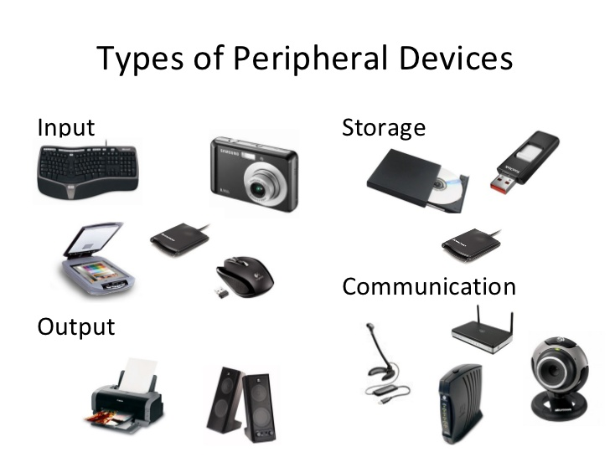

Slide 5
Classification
By their functions
Input devices such as keyboards, mice, bar-code scanners and digitizers.
Output devices like printers, plotters and displays.
Storage devices, which include floppy and hard disks, optical disks and magnetic tape drives.
Multi-media devices and others
Peripheral devices will fall into one or more of these groups

Slide 6
Elements of the I/O Subsystem
Device: the thing that stores data or transfers data in and out of the system
Device Controller: electronics that interface between the CPU and the device
Device Driver: software that interacts with the device controller
Interrupt Handler: part of the device driver that is called when the controller generates an interrupt

Slide 7
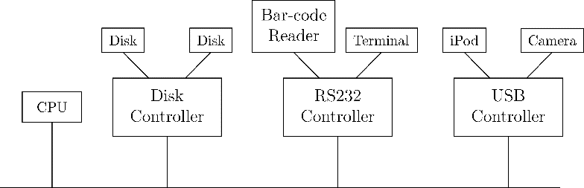
Typical I/O Configuration

Slide 8
I/O Service Concepts
Reliability: drivers deal with errors in I/O subsystem so that the subsystem appears reliable
Device independence: applications use the same mechanisms to access all devices
Blocking (synchronous) calls: system calls don't return until operation is complete
Nonblocking (asynchronous) calls: system calls return immediately

Slide 9
Device Driver Structure
Upper half: takes requests from the rest of the OS and queues requests in a shared request list
Lower half: takes requests from the shared list and programs the controller to carry them out
Interrupt handler: part of the lower half that is called when the controller generates an interrupt

Slide 10
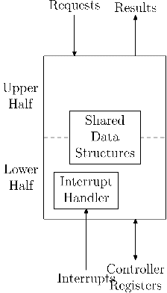
Device Driver Structure

Slide 11
Output Devices

Slide 12
Monitors
Technically known as Visual Display Unit
Display devices that aids users in viewing computer output.
Transmits information from computer to screen
Computer display screens have been evolving and improving
CRT
LCD
LED
NB: They differ based on Size, Design, Color, Quality and Shape

Slide 13
CRT Monitors
Cathode Ray Tube
Invented 1897
Karl Ferdinand Braun a physicist
Technology also used in the manufacturing of televisions

Slide 14
CRT Monitors
An electron gun produces a stream of electrons
The electrons are accelerated by a strong field between the cathode and anode
The electron beam is deflected by a capacitor or coils which makes it display an image on the screen.
When electrons hit the fluorescent screen, light is emitted.
The process is done in a vacuum to avoid collision between electrons and gas molecules
Uses RGB colors
Notes:
The source of the electron beam is the electron gun, which produces a stream of electrons through thermionic emission at the heated cathode and focuses it into a thin beam by the control grid (or “Wehnelt cylinder”).
A strong electric field between cathode and anode accelerates the electrons, before they leave the electron gun through a small hole in the anode.
The electron beam can be deflected by a capacitor or coils in a way which causes it to display an image on the screen. The image may represent electrical waveforms (oscilloscope), pictures (television, computer monitor), echoes of aircraft detected by radar etc.
When electrons strike the fluorescent screen, light is emitted.
The whole configuration is placed in a vacuum tube to avoid collisions between electrons and gas molecules of the air, which would attenuate the beam.

Slide 15
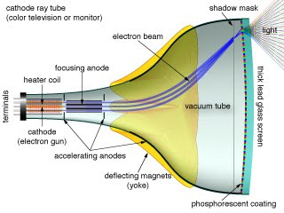
CRT Monitors

Slide 16
LCD Monitor
Flat panel display monitor
Liquid Crystal Display or in some cases liquid crystal diode
Uses polarized blocked light
Consists of a layer of color or monochrome pixels arranged schematically between a couple of transparent electrodes and two polarizing filters
Optical effect is achieved by polarizing the light in varied amounts and making it pass through the liquid crystal layer
Types:
Active matrix of TFT (Thin Film Transistor): reliable, better picture quality
Passive matrix: slow response time, less quality
Notes:
Liquid crystal display, also known as liquid crystal diode, is one of the most advanced technologies available at present. Typically, an LCD monitor consists of a layer of color or monochrome pixels arranged schematically between a couple of transparent electrodes and two polarizing filters.
Optical effect is achieved by polarizing the light in varied amounts and making it pass through the liquid crystal layer. At present, there are two types of LCD technology available. These include the active matrix or TFT and a passive matrix technology. Among these, TFT technology is more secure and reliable, and generates better picture quality. On the other hand, passive matrix has a slow response time and is slowly becoming outdated.

Slide 17
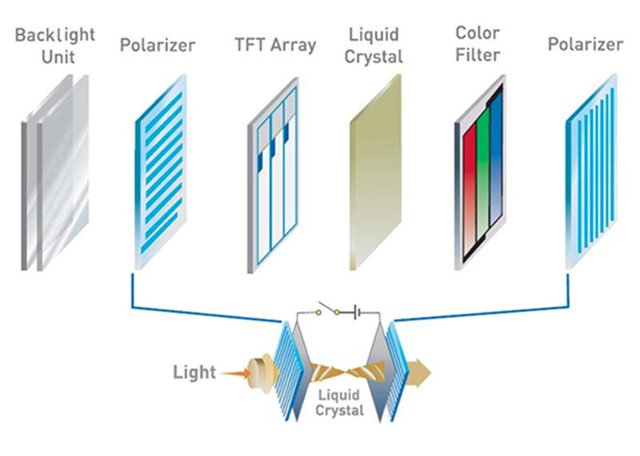
LCD Monitor

Slide 18
Advantages
These monitors are compact, lightweight, and do not consume much desk space.
The monitors do not consume much electricity and can even be operated by using batteries.
Also, the images transmitted by these monitors do not get geometrically distorted and have little flicker.

Slide 19
Disadvantages
LCD monitors are very expensive.
Image quality is not constant when viewed from different angles.
LCD monitor’s resolution is always constant. Any alterations can result in a reduced performance

Slide 20
LED Monitors
Light Emitting Diode
Light-emitting diodes for back-lightning instead of Cold Cathode Fluorescent (CCFL) back-lightning used in LCDs.
Primarily, the display is of LCD only that the back-lightning is done by LEDs.
LED monitors use much lesser power than CRT and LCD.

Slide 21
Printers
Output device
Provides text and graphics on a physical medium such as paper
The printed output is referred to as hard copy
Information generated can easily be shared.
Can be classified into:
Impact and non-impact.
Continuous feed and sheet feed
Line and page.

Slide 22
Impact vs Non-impact
An impact printer forms characters and graphics on a piece of paper by striking a mechanism against an ink ribbon that physically contacts the paper.
A non-impact printer forms characters and graphics on a piece of paper without actually striking the paper.

Slide 23
Continuous feed Vs sheet feed
Sheet feed printers
single “free” sheet of paper, such as copy paper.
It isn’t attached to anything else.
It can be placed in a printer or be fed into a paper folding machine.
Continuous feed printer
Papers are usually attached to other sheets of paper by means of a perforated edge.

Slide 24
Line Vs Page
Page printer:
Computer printer that processes and prints a whole page at a time.
Line printer
Computer printer that prints one entire line of text at a time.

Slide 25
Types of Printers
Dot Matrix Printer
Inkjet Printer
Laser Jet Printer

Slide 26
Dot Matrix
Also known as impact matrix printing
Print head that runs back and forth, or up and down on the page
prints by impact
striking an ink-soaked cloth ribbon against the paper, much like the print mechanism on a typewriter.
Each dot is produced by a tiny metal rod, also called a "wire" or "pin", which is driven forward by the power of a tiny electromagnet or solenoid, either directly or through small levers (pawls).
Facing the ribbon and the paper with a small guide plate pierced with holes to serve as guides for the pins. This plate may be made of hard plastic or an artificial jewel such as sapphire or ruby. The portion of the printer containing the pins is called the print

Slide 27
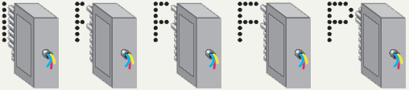
Dot Matrix Printer

Slide 28
Ink Jet
Creates a image by propelling droplets of ink onto paper, plastic, or other substrates.
There are two main technologies used in contemporary inkjet printers:
Continuous (CIJ) and Drop-on- demand (DOD).
Non-impact printer
Printer resolution is measured in dots per inch (dpi).
The speed of an ink-jet printer is measured in lines per minute (lpm).

Slide 29
InkJet
Inexpensive home printer
Color output common using CMYK
Cyan, magenta, yellow, black
Sprays ink onto paper
Speed measured in pages per minute
Quality expressed as dots per inch

Slide 30
InkJet
Advantages
Generally quiet.
Produce high quality color output.
Disadvantages
Specialized papers are required to produce high quality color output.
The ink cartridges and specialized papers are expensive.
The ink may smear when printed on ordinary paper

Slide 31
Laserjet
Laser printing is an electrostatic digital printing process
Non-impact, page and sheet feed printer.
Produces high quality text and graphics by passing a laser beam over a charged drum to define a differentially charged image.
The drum then selectively collects charged toner and transfers the image to paper, which is then heated to permanently fix the image.

Slide 32
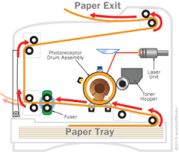
Laser Jet printer

Slide 33
Input Devices

Slide 34


Mouse & Keyboard
NB: Please be sure to verify the source of any information gathered

